Slide 1


Programming with C++
Chapter 3: Repetition Structures
Bujar Mamudi
Yahya Kemal College
Spring 2012

Slide 2
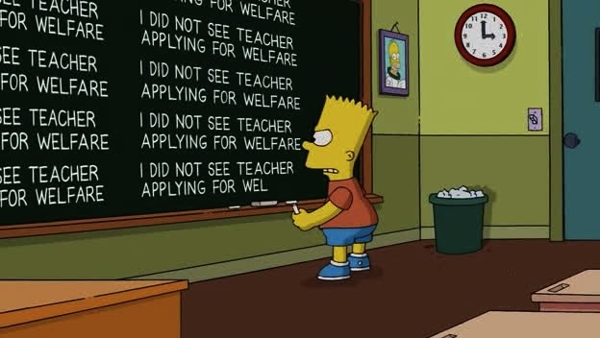
Bart Simpson got punished at class and had to write the same line over and over again.

Slide 3
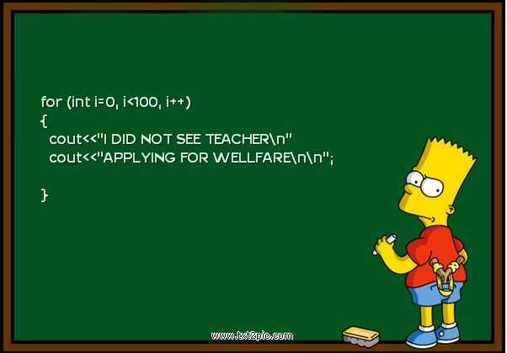
If he knew how to program he would have finished in 5 seconds ☺

Slide 4
Contents:
Repetition structures (Loops)
The while Loop
Increment and Decrement Operators
Counter-Controlled Loops
Sentinel-Controlled Loops
The do/while Loop
The for Loop
Break and Continue Statements
Nested Loops

Slide 5


Repetition Structures (Loops)

Slide 6
Repetition Structures ( Loops )
are used to repeat a block of code either a specific number of times or while some condition remains true.
Example:
Read 50 items from input file, or
while there are more items in the input file, continue reading from input.

Slide 7
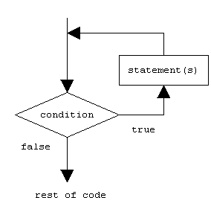
Repetition Structures

Slide 8
Repetition Structures
Repeating a block of code is one of the most basic but useful tasks in programming.
There are three kinds of repetition structures in C++:
while
do / while
for

Slide 9
The ‘while’ Loop

Slide 10
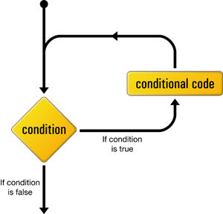
The ‘while’ Loop
The while loop structure is made up of a logical condition and the block of code to be repeated.

Slide 11
The ‘while’ Loop
First, the condition is evaluated, if it is true the statements in the block of code are executed, and then the condition is evaluated one more time.
The process continues until the condition becomes false.
The condition must become false at the end otherwise we can fall into an infinite loop.

Slide 12
The ‘while’ Loop
The while loop is called a pre-conditional repetition structure because it first checks the condition, and then decides if it will execute the statements.

Slide 13
Syntax
while (expression)
{
statement;
}

Slide 14
Problem: Print numbers from 1 to 10
Counter: a variable to keep track of numbers
Initial value: In our case it will be 1
Final value: In our case it will be 10
Increment Factor: counter should increase by 1
Condition: need to check if counter <=10
Statements: in our case it will be the value of the counter from 1 to 10

Slide 15
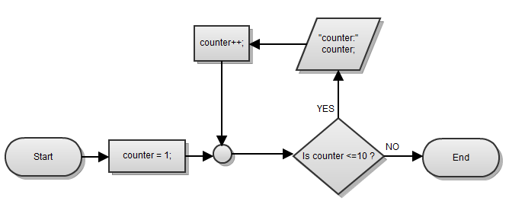
Flowchart

Slide 16

//DESCRIPTION: while loop to print numbers from 1 to 10
// increasing by 1.
#include <iostream>
using namespace std;
int main(int argc, char *argv[])
{
//declare the counter to keep track of the numbers
int counter = 1;
//loop until the counter reaches its final value
while( counter <=10)
{
//print the current value of the counter
cout<<counter<<" ";
//increment counter by 1
// counter = counter + 1;
counter++;
}
system("PAUSE");
return EXIT_SUCCESS;
}

Slide 17
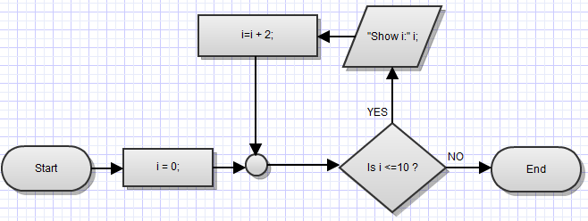
Problem: Print even numbers from 0 to 10
Write a C++ program that will print even numbers only from 0 to 10.

Slide 18

//DESCRIPTION: while loop to print even numbers from 0 to 10 //increasing by 2.
#include <iostream>
using namespace std;
int main(int argc, char *argv[])
{
//declare the counter to keep track of the numbers
int i = 0;
//loop until the counter reaches its final value
while( i <=10)
{
//print the current value of the counter
cout<<i<<" ";
//increment counter by 2
// i = i + 2;
i +=2;
}
system("PAUSE");
return EXIT_SUCCESS;
}

Slide 19
Increment and Decrement Operators (revision from chapter 1)

Slide 20
Increment and Decrement Operators
C++ provides the unary increment (++) and decrement(--) operators.
They can be used before or after their operands.
Example: ++a (pre – increment)
a++ ( post – increment)
Alternative: a = a + 1;
a += 1;

Slide 21
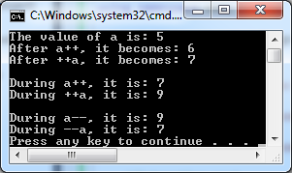
//DESCRIPTION: increment and decrement operators in action
#include <iostream>
using namespace std;
int main(int argc, char *argv[])
{
int a = 5;
cout<<"The value of a is: "<<a<<endl;
a++;
cout<<"After a++, it becomes: "<<a<<endl;
++a;
cout<<"After ++a, it becomes: "<<a<<endl<<endl;
//interesting part
cout<<"During a++, it is: "<<a++<<endl;
cout<<"During ++a, it is: "<<++a<<endl<<endl;
cout<<"During a--, it is: "<<a--<<endl;
cout<<"During --a, it is: "<<--a<<endl;
system("PAUSE");
return EXIT_SUCCESS;
}

Slide 22
Easy Problem:Molecules
Calculate the mass of a molecule.
Example: H2O has mass 2*1+1*16 =18
First line of input contains an integer N that denotes the number of atoms in a molecule.
Each of the following lines represents an atom with two integers, first is mass, second is quantity.
2 2 1
18

Slide 23
// DESCRIPTION: a program that finds the mass of a molecule
#include <iostream>
using namespace std;
int main(int argc, char *argv[])
{
// declare variables for input
int n, mass, quantity;
//declare variable for output
int totalMass = 0;
cout<<"Please enter number of atoms:";
cin>>n;
//declare the counter for the loop
int counter = 0;
while(counter < n)
{
cout<<"Enter atom mass and quantity:";
cin>>mass>>quantity;
//update totalMass
totalMass += (mass * quantity);
//update counter
counter++;
}
//show result
cout<<"\nThe mass of the molecule is:"<<totalMass<<endl;
return 0;
}

Slide 24
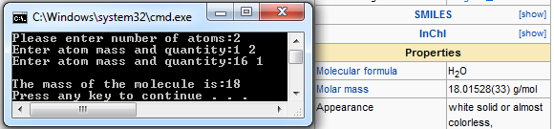
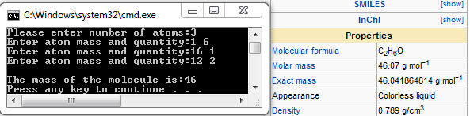
Result

Slide 25
Intermediate Problem: Molecules (working with files)
Calculate the mass of a molecule.
Take input from a file named “chem.in”, and save the result in a file named “chem.out”
First line of input contains an integer N that denotes the number of atoms in a molecule.
Each of the following lines represents an atom with two integers, first is mass, second is quantity.
2 2 1
18

Slide 26
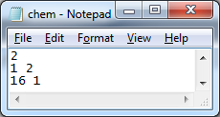
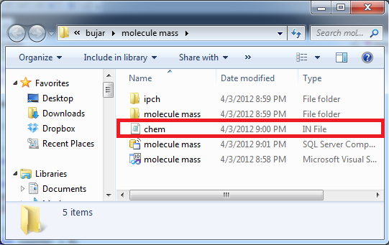
Molecules (working with files)
So we must include the <fstream> library
In the project folder, we must manually create the file “chem.in” having values:

Slide 27
//DESCRIPTION: a program that finds mass of molecule with files
#include <fstream>
using namespace std;
int main(int argc, char *argv[])
{
//open the input file, create the output file
ifstream fin("chem.in");
ofstream fout("chem.out");
int n, mass, quantity;
int totalMass = 0;
//read the first line from file
fin>>n;
//declare the counter for the loop
int counter = 0;
while(counter < n)
{
//read the other lines from the file
fin>>mass>>quantity;
totalMass += (mass * quantity);
counter++;
}
//write the result to the output file
fout<<totalMass<<endl;
//close both files
fin.close();
fout.close();
return 0;
}

Slide 28
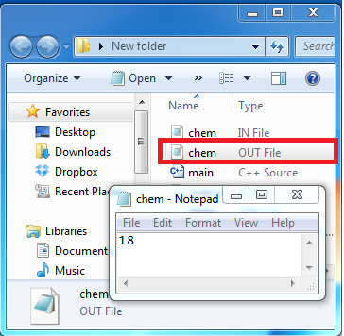
Result

Slide 29
Advanced Problem: Molecules
Modify the program “Molecules so that it calculates the mass of a molecule without using any variable as counter.
When working with <iostream> library, it’s impossible to do this with a while loop, because you don’t know before hand how many times you have to loop, (actually it is, but you will learn it later on!)

Slide 30
Molecules
Instead we will work with the <fstream> library, because it already provides a function called eof() – end of file
eof() checks if we have reached the last line of the file(the end of the document).
BUT: its unsafe, it may mess up your code, so avoid it like the plague!
Instead, just test what you read from the file
while(fin>>mass>>quantity)

Slide 31
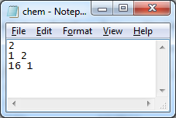
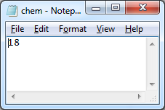
//DESCRIPTION: THE UNSAFE & LONG WAY
#include <fstream>
using namespace std;
int main(int argc, char *argv[])
{
ifstream fin("chem.in");
ofstream fout("chem.out");
int n, mass, quantity;
int totalMass = 0;
//get rid of first line
fin>>n;
while(1)
{
fin>>mass>>quantity;
// if it is the end of file, stop the loop
if(fin.eof())
{
break;
}
else
{
totalMass += (mass * quantity);
}
}
//write the result to the output file
fout<<totalMass<<"\n";
fin.close();
fout.close();
return 0; }

Slide 32
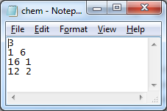
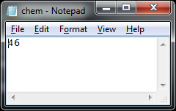
//DESCRIPTION: THE SAFE & SHORTER WAY!
#include <fstream>
using namespace std;
int main(int argc, char *argv[])
{
ifstream fin("chem.in");
ofstream fout("chem.out");
int n, mass, quantity;
int totalMass = 0;
//get rid of first line
fin>>n;
//while there is input to be read
while(fin >> mass >> quantity)
{
totalMass += (mass * quantity);
}
//write the result to the output file
fout<<totalMass<<"\n";
fin.close();
fout.close();
return 0;
}

Slide 33
Problem: Train
A train leaves the first station with N passengers and visits K stations before it arrives at the last station.
In each station some passengers got off the train and some passengers got on the train.
Everybody in the train got off at the last station.

Slide 34
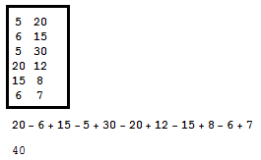
Problem: Train
Write a C++ program that calculates how many passengers got off the train at the last station.
First line of input has two integers K and N.
Each of the following lines has two integers, the first denotes the number of passengers who got off, the second the number of passengers who got on the train.

Slide 35
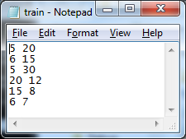
Problem: Train
We are going to solve this problem using the <fstream> library, using a file named “train.in”
You must manually create this file in your project folder.

Slide 36
#include<fstream>
using namespace std;
int main(int argc, char *argv[])
{
ifstream fin("train.in"); //open and create the files
ofstream fout("train.out");
int stationNum, passOff, passOn, totalPass; //declare the variables to use
fin>>stationNum; //read total number of stations
fin>>totalPass; //read initial passengers
int counter = 0; //declare counter and loop
while( counter < stationNum)
{
fin>>passOff; //read passengers leaving
totalPass -= passOff;
fin>>passOn; //read passengers entering
totalPass += passOn;
counter++; //update counter
}
fout<<totalPass<<'\n'; //write final result
fin.close(); //close files
fout.close();
return 0;
}

Slide 37
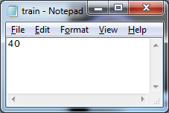
Result

Slide 38
Counter – Controlled Repetition

Slide 39
Counter - Controlled Loops
they use a variable called “counter” to control the number of times the statements will be executed.
The variable counter must be known and initialized before the loop starts, and it must be updated (incremented or decremented) inside the loop.

Slide 40
Counter - Controlled Loops
Counter – controlled repetitions are also called “definite repetitions” because the number of repetitions is known.

Slide 41
Problem: Class average
Write a C++ program that helps a teacher to find the average of the marks(from 1 to 5) after an exam.
Ask the teacher how many students took the exam, and then collect the marks one by one.
Show as result the class average.

Slide 42
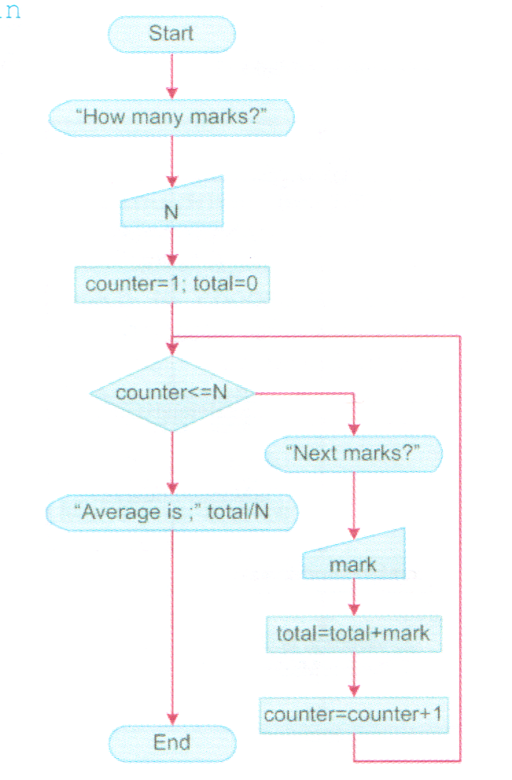

Slide 43
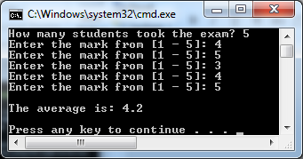
#include<iostream> //DESCRIPTION: find average
using namespace std;
int main(int argc, char *argv[])
{
//variable declarations
int studentNum, studentMark, totalMarks = 0;
float average;
int counter = 0; //counter declaration
cout<<"How many students took the exam? ";
cin>>studentNum;
while(counter < studentNum) //start loop
{
cout<<"Enter the mark from [1 - 5]: "; //get marks
cin>>studentMark;
totalMarks +=studentMark; //update total
counter++; //update counter
}
average = (float)(totalMarks) / studentNum; //find average
cout<<"\nThe average is: "<<average<<"\n\n"; //show result
}

Slide 44
Sentinel – Controlled Repetition sen·ti·nel (n.) One that keeps guard; a sentry.

Slide 45
Sentinel – Controlled Loops
are used when we don’t know the number of repetitions in advance.
Here, a special value (“the sentinel”) is used to look out for when the loop should stop.
The sentinel value must be chosen carefully so that it is not confused with legitimate input.

Slide 46
Problem: Class average
Write a C++ program to help a teacher find the average of the marks(from 1 – 5) if he does not know how many students took the exam.
(he/she is feeling too lazy to find out the exact number)

Slide 47
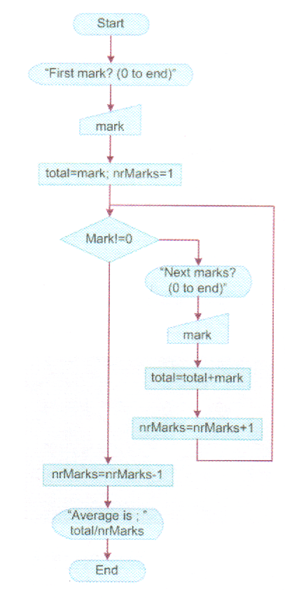

Slide 48
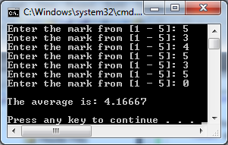
#include<iostream> //DESCRIPTION: find average using a sentinel controlled loop
using namespace std;
int main(int argc, char *argv[])
{
int studentMark, totalMarks, tracker = 0; //variable declarations
float average;
cout<<"Enter the mark from [1 - 5]: "; //get first mark
cin>>studentMark;
totalMarks = studentMark;
int SENTINEL = 0; //sentinel declaration
while(studentMark != SENTINEL) //start loop
{
cout<<"Enter the mark from [1 - 5]: "; //get marks
cin>>studentMark;
totalMarks +=studentMark; //update total
tracker++; //update tracker
}
average = (float)(totalMarks) / tracker; //find average
cout<<"\nThe average is: "<<average<<"\n\n"; //show result
}

Slide 49
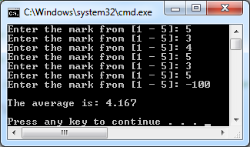
Floating point precision
If you want to format the output of the average to have an exact number of digits, you can use the setprecision() function by including the library <iomanip>
#include<iomanip>
. . .
cout<<"\nThe average is: "<<setprecision(4)<<average<<"\n\n";

Slide 50
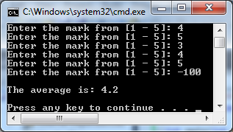
#include<iostream> //DESCRIPTION: alternative version
using namespace std;
int main(int argc, char *argv[])
{
int studentMark=0, totalMarks=0, tracker=0; //variable declarations
float average;
int SENTINEL = -100; //sentinel declaration
while(studentMark != SENTINEL) //start loop
{
cout<<"Enter the mark from [1 - 5]: "; //get marks
cin>>studentMark;
totalMarks +=studentMark; //update total
tracker++; //update tracker
}
// remove sentinel from the result and tracker
average = (float)(totalMarks - SENTINEL) / (tracker -1);
cout<<"\nThe average is: "<<average<<"\n\n"; //show result
}

Slide 51
The ‘do / while’ Loop

Slide 52
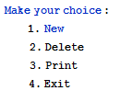
The ‘do / while’ Loop
it performs a test after each execution of the loop body, therefore the loop body is executed at least once.
The ‘do / while’ repetition structure it is usually used to implement menu-driven programs.

Slide 53
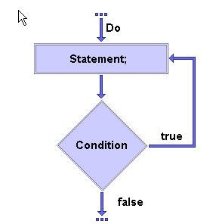
The ‘do / while’ Loop

Slide 54
Syntax
do
{
statements;
}
while (condition);

Slide 55
Problem: Print numbers from 1 to 10
Write a C++ program that prints the numbers from 1 to 10 with a ‘do / while’ loop.

Slide 56
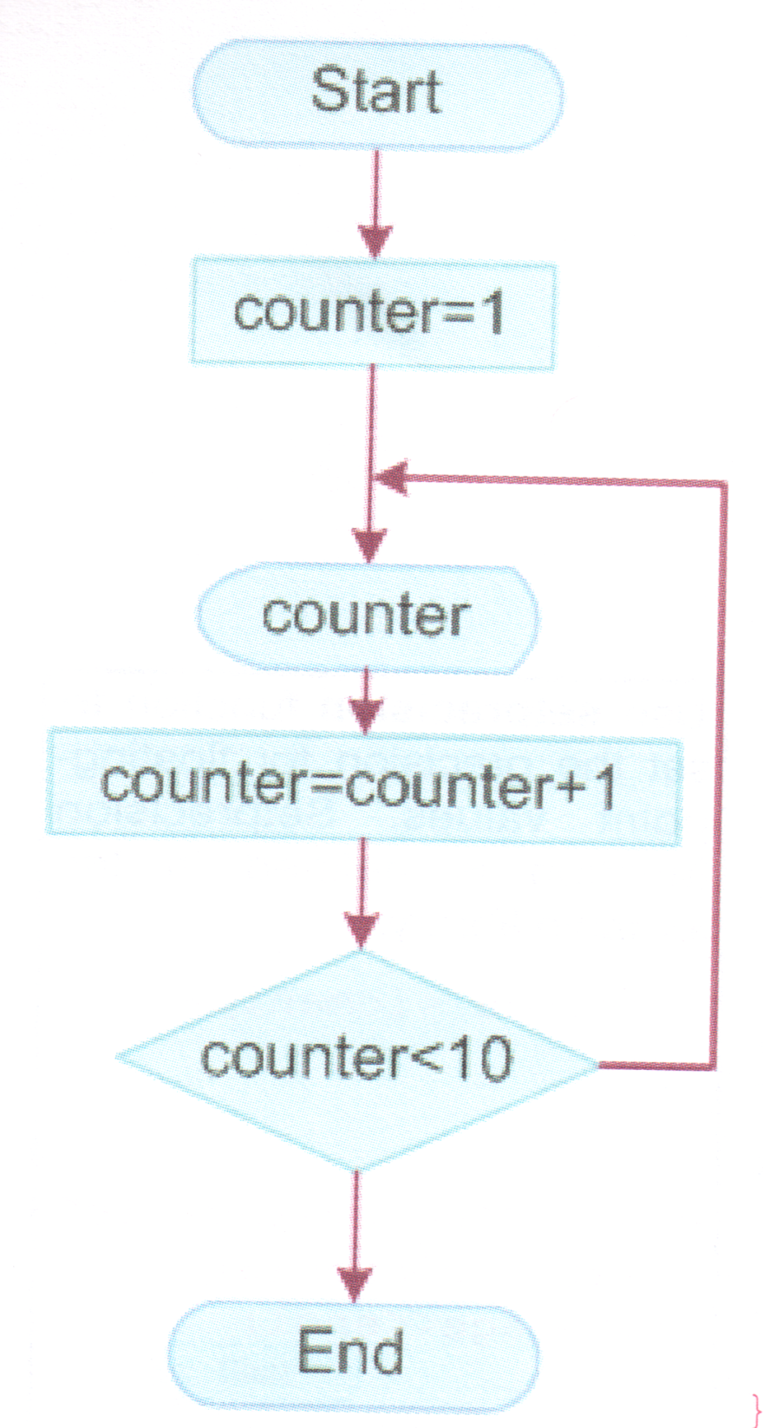

Slide 57

//DESCRIPTION: 'do/while' loop from 1 to 10
#include<iostream>
using namespace std;
int main(int argc, char *argv[])
{
//declare the counter
int i = 1;
do
{
cout<<i<<" "; //show current value of counter
i++; // update counter
}
while(i <= 10);
return 0;
}

Slide 58
Problem: Guess the number
The game “guess the number” is played between two players.
The first player selects an integer at random in the range 1 to 1000.
The second player makes his first guess.
The second player responds with “Too low”, “Too high”, “You guessed the number”.

Slide 59
Random Numbers
To generate a random number we can use the rand() function – generate a random number from 0 to RAND_MAX(32767).
The random numbers should be from 1 – 1000
rand() % 1001 + 1
We can seed the random numbers with the srand() function.
srand ( (unsigned) time (NULL) );

Slide 60
#include<iostream> //DESCRIPTION: guess the number
#include<time.h>
using namespace std;
int main(int argc, char *argv[])
{
srand ((unsigned) time (NULL)); // seed random number with system time
int number = rand() % 1001 + 1; //save random number
int guess; //variable for the guess
do
{
cout<<"Please guess the number:"; //get input
cin>> guess;
if (guess > number) //check if too high
{
cout<<"Too high\n";
}
if (guess < number) //check if too low
{
cout<<"Too low\n";
}
}
while( guess != number);
cout<<"\n You guessed correctly\n\n"; // show correct result
return 0;
}

Slide 61
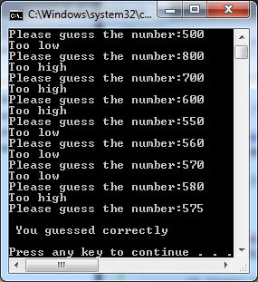
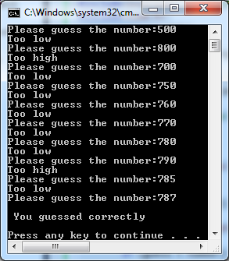
Problem: Guess the number

Slide 62
The ‘for’ Loop

Slide 63
The ‘for’ Loop
it enables you to evaluate a sequence of expressions multiple number of times.
For loops are best when you know the number of times that the expressions are needed to be evaluated in advance (counter-controlled repetition)

Slide 64
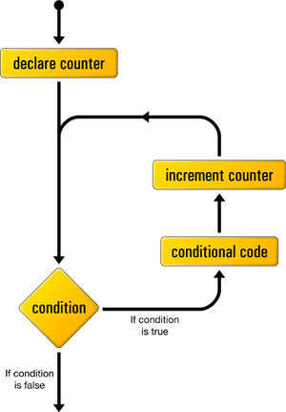
The ‘for’ Loop

Slide 65
Syntax
for (initialization; condition; increase)
{
statements;
}

Slide 66
Problem: Print numbers from 1 to 10
Write a C++ program that prints the numbers from 1 to 10 with a ‘for’ loop.

Slide 67

//DESCRIPTION: print numbers from 1 to 10 increasing by 1
#include <iostream>
using namespace std;
int main(int argc, char *argv[])
{
for(int i=1; i<=10; i++)
{
cout<<i<<" ";
}
return 0;
}

Slide 68
Problem: Factorial
Write a C++ program that reads a
non-negative integer and computes its factorial.
Example:
3! = 1*2*3=6
5! = 1*2*3*4*5=120

Slide 69
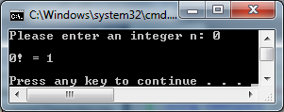
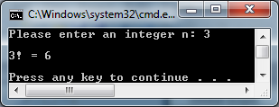
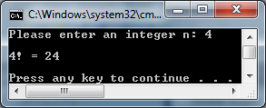
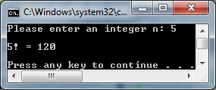
//DESCRIPTION: print the factorials with a for loop
#include <iostream>
using namespace std;
int main(int argc, char *argv[])
{
//variable declaration
int n, result=1;
//get user input
cout<<"Please enter an integer n: ";
cin>>n;
//find factorial
for(int i=1; i<=n; i++)
{
result *= i;
}
//show result
cout<<"\n"<<n<<"! = "<<result<<"\n\n";
return 0;
}

Slide 70
Problem: X to the power of Y
Write a C++ program that finds x raised to the power of y.
To get the result multiply x, y times.
Example x=5, y=3;
5*5*5=125

Slide 71
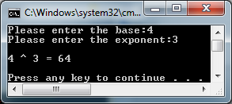
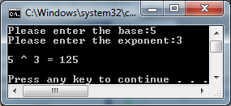
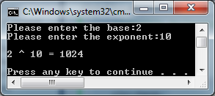
//DESCRIPTION: x to the power of y
#include <iostream>
using namespace std;
int main(int argc, char *argv[])
{
//variable declaration
int base, exponent;
long int result=1;
//get user input
cout<<"Please enter the base:";
cin>>base;
cout<<"Please enter the exponent:";
cin>>exponent;
//calculate the value
for( int i=0; i<exponent; i++)
{
result *= base;
}
//show result
cout<<"\n"<<base<<" ^ "<<exponent<<" = "<<result<<"\n\n";
return 0;
}

Slide 72
Problem: Fibonacci Series
Write a C++ program to print the first N Fibonacci numbers where N is a positive integer.
Fibonacci sequence:
0 1 1 2 3 5 8 13 21 34 …

Slide 73



//DESCRIPTION: print the Fibonacci numbers
#include <iostream>
using namespace std;
int main(int argc, char *argv[])
{
//variable declaration
int n, first=0, second=1;
//get user input
cout<<"Please enter an integer n: ";
cin>>n;
for (int i=0; i<n; i++)
{
//show first
cout<<first<<" ";
//exchange values
swap(first, second);
// update second
second +=first;
}
return 0;
}

Slide 74
Problem: Binary to decimal
Write a C++ program to read a binary number and print its decimal equivalent.
Example
1001 1101 =
1*2⁷ + 0*2⁶ + 0*2⁵ + 1*2⁴ + 1*2³ + 1*2² + 0*2¹ + 1*2⁰
= 128 + 16 +8 + 4+ 1
= 157

Slide 75
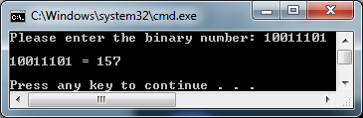
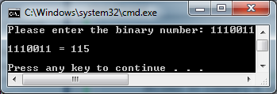
//DESCRIPTION: convert binary numbers to decimal
#include <iostream>
#include<cmath>
using namespace std;
int main(int argc, char *argv[])
{
// variable declaration
int binary, decimal=0;
//get input
cout<<"Please enter the binary number: ";
cin>>binary;
//declare counter
int i=0;
//show result
cout<<"\n"<<binary << " = ";
//calcualte decimal
while( binary > 0)
{
// get the digit and multiply with 2 to power of position
decimal += ((binary % 10) * pow(2.0, i));
//update binary
binary /= 10;
//increment counter
i++;
}
//show result
cout<<decimal<<"\n\n";
return 0;
}

Slide 76
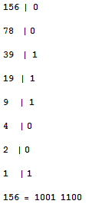
Problem: Decimal to binary
Write a C++ program to read a decimal number and prints its binary equivalent.
Example:

Slide 77
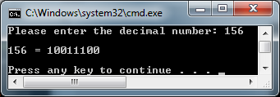
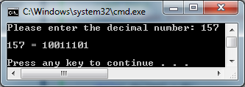
//DESCRIPTION: decimal to binary
#include <iostream>
#include <cmath>
using namespace std;
int main(int argc, char *argv[])
{
// variable declaration
int decimal, binary=0;
//get input
cout<<"Please enter the decimal number: ";
cin>>decimal;
// show result
cout<<"\n"<<decimal<<" = ";
//declare counter
int i = 0;
while( decimal > 0)
{
// get the binary digit
binary += (decimal % 2) * pow(10.0, i);
//update decimal
decimal /=2;
//update counter
i++;
}
//show result
cout<<binary<<"\n\n";
return 0;
}

Slide 78
Problem: Maximum
Write a C++ program to decides the maximum number from a list of integers.
Ask the user for how many numbers
Print the maximum

Slide 79
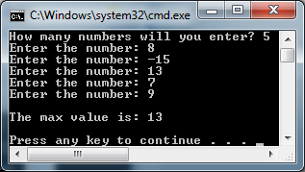
//DESCRIPTION: print greatest number
#include <iostream>
using namespace std;
int main(int argc, char *argv[])
{
//variable declaration
int n, num, max=0;
//get user input
cout<<"How many numbers will you enter? ";
cin >>n;
//get max
for(int i=0; i<n; i++)
{
//get the number
cout<<"Enter the number: ";
cin>> num;
//check if it is the greatest
if ( num > max)
{
max = num;
}
}
//show result
cout<<"\nThe max value is: "<<max<<"\n\n";
return 0;
}

Slide 80
The ‘break’ and ‘continue’ statements

Slide 81
The ‘break’ statement
break; - stops the loop in which it resides.
The program flow continues to the next statements after the loop.
while (1)
{
cin>>letter;
if (letter == '\n')
break;
}

Slide 82
Problem: Menu
Write a C++ program that uses an infinite loop to show a menu with three options:
1 – Greeting – print “Hello, there”
2 – Message- print “Answer to the Ultimate Question of Life, the Universe, and Everything is 42”
3 – Exit - stop loop

Slide 83
//DESCRIPTION: infinite loop menu
#include <iostream>
using namespace std;
int main(int argc, char *argv[])
{
while(1)
{
//show menu
cout<<"Menu:\n"; cout<<"1 - Hello\n"; cout<<"2 - Message\n"; cout<<"3 - Exit\n\n";
//variable declarations
int choice; bool flag=false;
//get user input
cout<<"Please enter your choice: ";
cin>>choice;
//show response
switch(choice)
{
case 1:
cout<<"Hello, there\n\n";
break;
case 2:
cout<<"The Answer to the Ultimate Question of Life, the Universe, and Everything is 42\n\n";
break;
case 3:
//set flag to true
flag = true;
break;
default:
cout<<"Wrong input\n\n";
}
//if its the third choice
if (flag == true) { break; }
}
return 0;
}

Slide 84
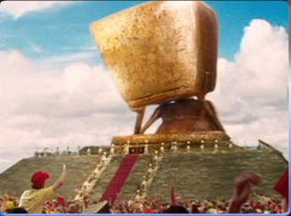
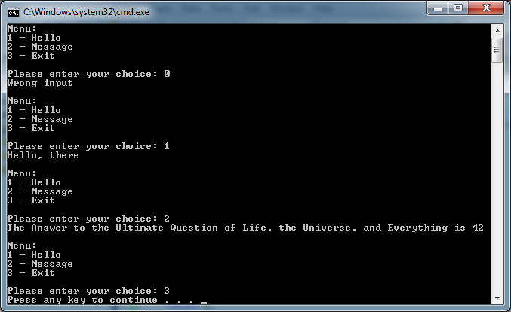
Result

Slide 85
The ‘continue’ statement
continue; - skip the rest of the loop in the current iteration.
The program continues with the start of the following iteration.
for (int i=0; i < 20; i++)
{
// if the number is divisible by 4, skip this iteration
if ((i % 4) == 0)
continue;
cout << i << endl;
}

Slide 86
Problem: Skip on number
Write a C++ program print numbers from 1 to 10 but skip on 5.

Slide 87

//DESCRIPTION: skip number 5
#include <iostream>
using namespace std;
int main(int argc, char *argv[])
{
for(int i = 1; i<=10; i++)
{
//check if counter is 5
if (i == 5)
{
continue;
}
cout<<i<<" ";
}
return 0;
}

Slide 88
Problem: Skip even numbers
Write a C++ program to print odd numbers from 1 to 10 by skipping all even numbers along the way.

Slide 89

//DESCRIPTION: skip even numbers
#include <iostream>
using namespace std;
int main(int argc, char *argv[])
{
for(int i = 1; i<=10; i++)
{
//check if counter is even
if (i % 2 == 0)
{
continue;
}
cout<<i<<" ";
}
return 0;
}

Slide 90
Which loop to use?

Slide 91
Which loop to use?
Loop Type | Description
while | It’s straightforward to use in numerous situations.
do / while | It’s a good choice when you are asking a question, whose answer will determine if the loop is repeated.
for | It’s a good choice when the number of repetitions is known.

Slide 92
Nested Loops

Slide 93
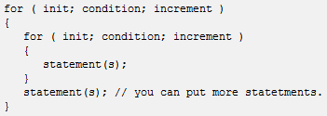
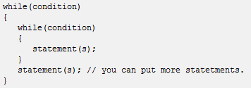
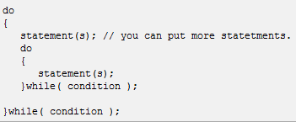
Nested loops
Loops that can be nested inside other loops.
A loop within a loop. (loop-ception)

Slide 94
Nested loops
The first iteration of the outer loop triggers the inner loop, which executes to completion.
Then the second iteration of the outer loop triggers the inner loop again.
This repeats until the outer loop finishes.

Slide 95
Understanding Nested loops
#include <iostream>
using namespace std;
int main(int argc, char *argv[])
{
for(int i=0; i<10; i++)
{
cout<<"i = "<<i<<endl<<"j: ";
for(int j=0; j<10; j++)
{
cout<<j<< " ";
}
cout<<endl<<endl;
}
}

Slide 96
Understanding Nested loops
#include <iostream>
using namespace std;
int main(int argc, char *argv[])
{
for(int i=0; i<10; i++)
{
cout<<"i = "<<i<<endl<<"j: ";
for(int j=0; j<i; j++)
{
cout<<j<< " ";
}
cout<<endl<<endl;
}
}

Slide 97
Problem: Number triangle.
Write a C++ program to print a number triangle.
Example:
1
1 2
1 2 3
1 2 3 4
1 2 3 4 5

Slide 98
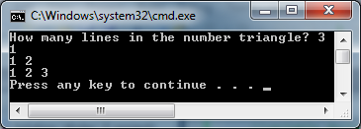


//DESCRIPTION: print number triangle
#include <iostream>
using namespace std;
int main(int argc, char *argv[])
{
//variable declaration;
int n;
//get user input
cout<<"How many lines in the number triangle? ";
cin>> n;
for(int i = 1; i <= n; i++)
{
for (int j=1; j <= i; j++)
{
//show outer loop counter
cout<<j<<" ";
}
//move to next line in the inner loop
cout<<"\n";
}
return 0;
}

Slide 99

Problem: Prime Numbers
Write a C++ program to print all the prime numbers less then or equal to a given number N.

Slide 100

//DESCRIPTION: print prime numbers less than integer n
#include <iostream>
using namespace std;
int main(int argc, char *argv[])
{
//variable declaration;
int n;
bool isPrime = true;
//get user input
cout<<"Please enter an integer n: ";
cin>> n;
for( int i=2; i<n; i++)
{
for( int j = 2; j<=n; j++)
{
//check if "i" is not prime
if((i != j) && (i % j == 0))
{
isPrime = false;
break;
}
}
//show prime
if (isPrime)
{
cout<< i << " ";
}
//update the prime flag
isPrime = true;
}
return 0;
}

Slide 101
Problem: Perfect Numbers
Write a C++ program to print all the perfect numbers less then or equal to a given number N.
A perfect number is an integer, greater than zero, when you add up all of the factors less then the number, you get that number.
Example 6 = 1 + 2 + 3;
28 = 1 + 2 + 4 + 7 + 14

Slide 102

//DESCRIPTION: print all perfect numbers less than n
#include <iostream>
using namespace std;
int main(int argc, char *argv[])
{
//variable declaration;
int n;
//get user input
cout<<"Please enter an integer n: ";
cin>> n;
//find perfect numbers
for(int i=1; i<=n; i++)
{
// variable to save the sum of factors of i
int sum = 0;
for ( int j=1; j<i; j++)
{
//save the sum of factors j of i
if ( i % j == 0)
{
sum +=j;
}
}
// check if i is equal to sum of factors i.e. perfect number
if ( i == sum)
{
// show the perfect number
cout<< i <<" ";
}
}
return 0;
}

Slide 103
Summary

Slide 104
Summary
Repetition structures execute a series of statements multiple times until a certain condition is meet.
C++ provides three sorts of repetition structures: “while”, “do / while” and “for”

Slide 105
Summary
“while”, and “for” are pre-conditional loops, whereas “do/while” is a post-conditional loop.
Repetition structures can be counter-controlled or sentinel-controlled depending on the condition test.

Slide 106
Summary
The break and continue statements are used to handle exceptions conditions within loops.
The break statement is used to exit the current loop before the normal ending.
The continue statement causes the current iteration to be skipped.

Slide 107
Summary
The placing of one loop inside the body of another loop is called nesting.
In a nested loop, the outer loop takes control of the number of complete repetitions in the inner loop.

Slide 108
Review Questions

Slide 109
Which structure repeats a block of code?
Decision
Loop
Cycle
Continue

Slide 110
Which of the following is not a repetition structure?
while
do / while
for
switch

Slide 111
Which statements cause the program execution to skip an iteration of a loop and continue with the next iteration?
continue
break
if
return

Slide 112
How are the decision and repetition structures called in programming?
loop
sequential
control
basic

Slide 113
What is the output of the following program?
#include <iostream>
using namespace std;
int main(int argc, char *argv[])
{
for( char ch1 = 'A'; ch1 <= 'D'; ch1++)
{
for(char ch2='D'; ch2 >= ch1; ch2--)
{
cout<<ch2<<" ";
}
cout<<"\n";
}
return 0;
}

Slide 114
What is the output of the following program?
#include <iostream>
using namespace std;
int main(int argc, char *argv[])
{
int result, a, b;
result = 0;
a = 10;
while (a > 0)
{
b = 1;
do
{
a -= b;
result += b;
b *= 2;
}
while( b < a);
result += a;
}
cout<<a<<" "<<b<<" "<<result<<endl;
return 0;
}

Slide 115
Programming Problems

Slide 116
Fahrenheit – Celsius Table
Build programs based on loop algorithms using the repetition statements:
· To display a table of Fahrenheit Celsius temperature degrees in range 0 … 100 (+20) F = 9/5 * C + 32 or
C = 5/9 * (F – 32);

Slide 117
Distance Traveled
Build programs based on loop algorithms using the repetition statements:
To display the distance driven by an automobile traveled at an average speed of 55 miles/hour after .5, 1.0, 1.5, … 4.0 hours;

Slide 118
Multiplication Table
Build programs based on loop algorithms using the repetition statements:
To show the multiplication table:
0*0=0
….
10*10=100

Slide 119
Wonder Primes
A wonder prime is a number that can be partitioned into two prime numbers, each of which has at least D digits.
When D=2, the number 11329 is a wonder prime ( since it connects 113 and 29, both of which are prime).

Slide 120
Wonder Primes
Your job is to find the first wonder prime greater or equal to a supplied integer N when you are given D.
INPUT: 2 11328
OUTPUT: 11329

Slide 121
Round Numbers
A positive integer N is said to be a “round number” if the binary representation of N has as many or more zeroes as it has ones.
For example, the integer 9, when written in binary form, is 1001 and it has two zeros and two ones; thus, 9 is a round number.
The integer 26 in binary is 11010 in binary, since it has two zeros and three ones, it is not a round number.

Slide 122
Round Numbers
Write a program that tells how many round numbers appear in the inclusive range given by the input.
INPUT: 2 12
OUTPUT: 6
Explanation:
2(round), 3(not round), 4(round), 5(not round),
6(not round), 7(not round), 8(round), 9(round),
10(round), 11(not round), 12(round).

Slide 123
Tower of happiness
The tower of happiness is located in the garden of effort. Happiness is waiting for you in the top chamber of the tower.
The stairs that lead you to the chamber has N steps and you are allowed to climb up one or two steps from your current location.

Slide 124
Tower of happiness
The door of the chamber will be open only if you could climb the steps in a secret combination. Of course, finding this secret combination is a matter of chance.
For instance, you may choose on of the three ways to climb a three-step stairs: 0 1 2 3, or 0 1 3, or 0 2 3

Slide 125
Tower of happiness
Write a C++ program to determine how many different ways you can climb up the tower of happiness when you are given the number of steps.
You must start from the ground which is step 0. The higher the tower is, the smaller the chance of catching the happiness gets.
INPUT: 3
OUTPUT: 3

Slide 126
Consanguineous
Blood types are inherited, and each biological parent donates one ABO allele to the child.
For example, a child of two parents each having blood type A could have either type A or type O blood.
A child of parents with blood types A and B could have any blood type.

Slide 127
Consanguineous
Each person’s blood has two parkers called ABO alleles. Each of these markers is represented by a character chosen from the set {A, B, O}.
This gives six possible combinations: AA, AB, AO, BB, BO, and OO.
The ABO blood type for people with these combinations of alleles are A, AB, A, B, B, and O, respectively.

Slide 128
Consanguineous
In this problem you are given a list of the blood types of many couples.
You should determine the set of blood types that might characterize their children.
INPUT: integer N- denotes number of couples, each of the following N- lines contains two alleles, those are the blood types of the couple.

Slide 129
Consanguineous
INPUT: integer N- denotes number of couples, each of the following N- lines contains two alleles, those are the blood types of the couple.
OUTPUT: has N- lines, each contains the possible blood types of a child.
alleles.in
alleles.out
3 A B AB AB O O
A B AB O A AB B O

Slide 130
Nim
Its also known as the Marienbad game, is a kind of logic game which is played between tow players.
The game starts with N items( e.g. fire matches) and the purpose of the game is to take the last item.

Slide 131
Nim
Initially there are N items on the table between two players.
The first player may take at least 1, at most M items. Then the second player may take at least 1, at most M items.
They continue in this way in turn until there are no items to take anymore. The one who takes the last item is the winner.

Slide 132
Nim
You have to write a program to play this game. Consider that your opponent plays the game perfectly .
nim.in
nim.out
5 3
You will win. Start with 1.

Slide 133
Nim
INPUT: one line having two integers N(the number of all the items) , and M(the number of the items that can be taken at a time) ( 1 <= N, M <=200)
OUTPUT: “You will win” or “You will lose”. Start with “X” where X is the number of items you must take to win the game.
nim.in
nim.out
5 3
You will win. Start with 1.

Slide 134
Class Average
You are asked to write a C++ program to calculate the average of a class from a school subject such as Mathematics.
There are N number of students in the classroom, some students have only one mark, some students have more than one mark, and some students have no mark at all.
The marks are between 1 and 10.

Slide 135
Programming with C++
?
?
?
?
?
Questions?
?
?
?
?
?
© 2012 Bujar Mamudi

